Slide 1
Robotics parts

Slide 2
Robots are distinguished from each other by the effectors and sensors with which they are equipped.
A mobile robot requires some kind of legs or wheels, and a teleoperated robot needs a camera.
A robot has some sort of rigid body, with rigid links that can move about.
Links meet each other at joints, which allow motion.
Attached to the final links of the robot are end effectors, which the robot uses to interact with the world.
End effectors may be suction cups, squeeze grippers, screwdrivers, welding guns, or paint sprayers, to name a few.

Slide 3
Some robots have special connectors on the last link that allow them to quickly remove one end effector and attach another.
The well-equipped robot also has one or more sensors, perhaps including cameras, infrared sensors, radar, sonar, and accelerometer.

Slide 4
Effectors: Tools for action
An effector is any device that affects the environment, under the control of the robot.
An effector must be equipped with an actuator that converts software commands into physical motion.
The actuators themselves are typically electric motors or hydraulic or pneumatic cylinders.
For simplicity, we will assume that each actuator determines a single motion or degree of freedom.
Effectors are used in two main ways: to change the position of the robot within its environment (locomotion), and to move other objects in the environment (manipulation).

Slide 5
Locomotion
The vast majority of land animals use legs for locomotion.
Legged locomotion turns out to be very difficult for robots, and is used only in special circumstances.
The most obvious application is motion in rough terrain with large obstacles.
The Ambler robot, for example, is a six-legged robot, about 30 feet tall, capable of negotiating obstacles more than 6 feet in diameter.
The Ambler is a statically stable walker. That is, it can pause at any stage during its gait without tumbling over.

Slide 6
The quest for faster, more efficient legged machines has led to a series of dynamically stable hopping robots which would crash if forced to pause, but do well as long as they keep moving.
These robots use rhythmic motion of four, two, or even a single leg to control the locomotion of the body in three dimensions.
They do not have enough legs in contact with the ground to be stable statically, and will fall if their hopping motion stops.
They are dynamically stable because corrections to leg motion keep the body upright when it is bumped or when the ground is uneven.

Slide 7
Manipulation
Manipulators are the effectors that move objects in the environment.
The ancestors of robot manipulators were teleoperated mechanisms that allowed humans to manipulate hazardous materials, and that mimicked the geometry of a human arm.
Early robots as a rule followed this precedent, and have anthropomorphic kinematics.
kinematics is the study of the correspondence between the actuator motions in a mechanism, and the resulting motion of its various parts.

Slide 8
Most manipulators allow for either rotary motion (rotation around a fixed hub) or prismatic motion (linear movement, as with a piston inside a cylinder).
Figure in next slide shows the Stanford Manipulator, used in several early experiments in robotics.
This design has six rotary joints arranged sequentially.
A nearly anthropomorphic design is the Unimation PUMA shown in Figure in slide 10.
This design has six rotary joints arranged sequentially.
The shorthand description of its kinematic configuration is "RRRRRR“.

Slide 9
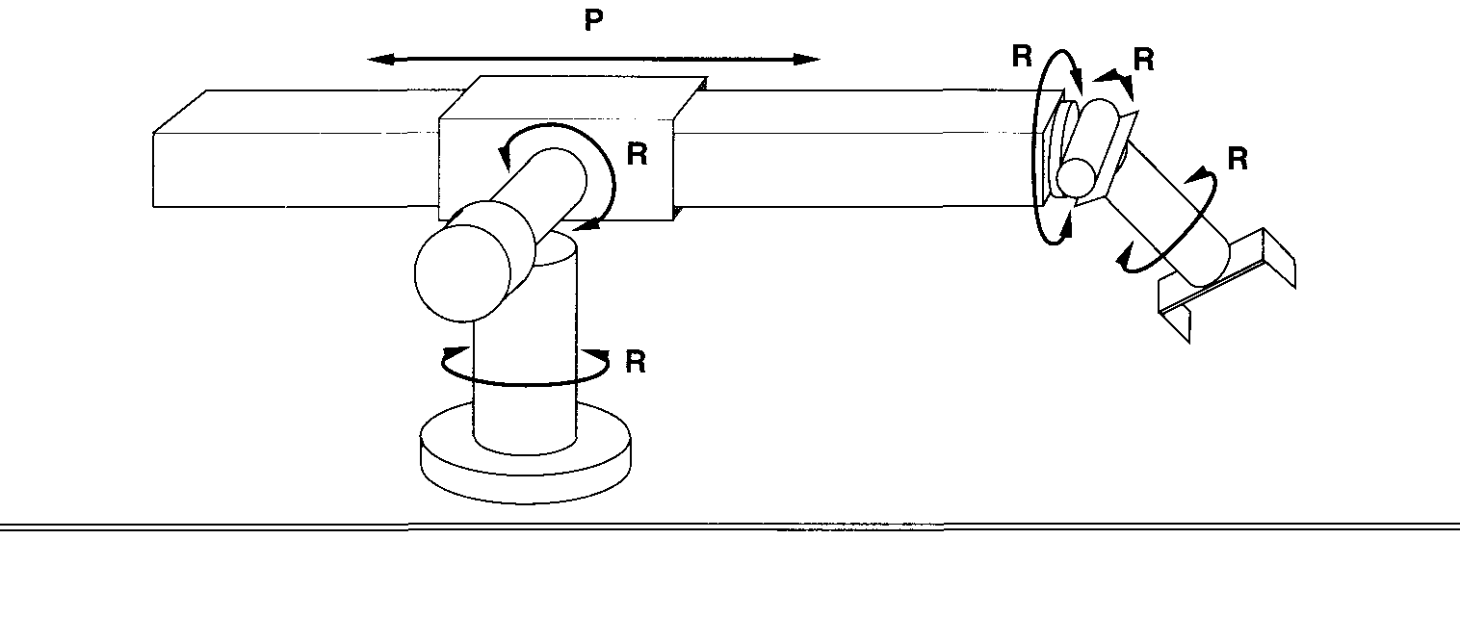
The Stanford Manipulator, an early robot arm with five rotary (R) and one prismatic (P) joints, for a total of six degrees of freedom.

Slide 10
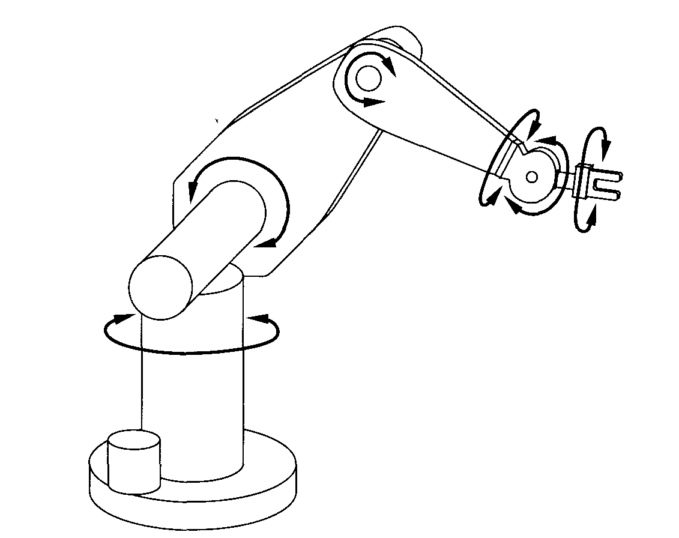

Slide 11
At the end of the manipulator is the robot's end effector, which interacts directly with objects in the world.
It may be a screwdriver or other tool, a welding gun, paint sprayer, or a gripper.
Grippers vary enormously in complexity.
Two- and three-fingered grippers perform most tasks in manufacturing.
The mechanical simplicity of these grippers makes them reliable and easy to control, both important attributes for manufacturing.
At the other end of the complexity spectrum are anthropomorphic hands.

Slide 12
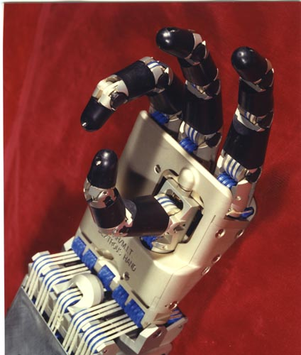
The Utah-MIT hand shown here faithfully replicates most of the kinematics of a human hand, less one finger.

Slide 13
Sensors: Tools for perception
Proprioception
Like humans, robots have a proprioceptive sense that tells them where their joints are.
Encoders fitted to the joints provide very accurate data about joint angle or extension.
If the output of the encoder is fed back to the control mechanism during motion, the robot can have much greater positioning accuracy than humans.
For a manipulator, this typically translates to around a few mils (thousandths of an inch) of accuracy in its end-effector position.
In contrast, humans can manage only a centimeter or two.

Slide 14
Mobots can measure their change in position using odometry, based on sensors that measure wheel rotation
Orientation can be measured more reliably, using a magnetic compass or a gyroscope system.
Accelerometers can measure the change in velocity.
Force sensing
Even though robots can sense and control the positions of their joints much more accurately than humans, there are still many tasks that cannot be carried out using only position sensing.
Consider, for example, the task of scraping paint off a windowpane using a razor blade.

Slide 15
To get all the paint requires positioning accuracy of about a micron in the direction perpendicular to the glass.
An error of a millimeter would cause the robot to either miss the paint altogether or break the glass.
Obviously, humans are not doing this using position control alone.
Force can be regulated to some extent by controlling electric motor current, but accurate control requires a force sensor.
These sensors are usually placed between the manipulator and end effector and can sense forces and torques in six directions.
Using force control, a robot can move along a surface while maintaining contact with a fixed pressure.

Slide 16
Such motions are called compliant motions, and are extremely important in many robotic applications.
Tactile sensing
Picking up a paper coffee cup or manipulating a tiny screw requires more than Proprioception.
The force applied to the cup must be just enough to stop it from slipping, but not enough to crush it.
Manipulating the screw requires information about exactly where it lies against the fingers that it contacts.
In both cases, tactile sensing (or touch sensing) can provide the needed information.
Tactile sensing is the robotic version of the human sense of touch.

Slide 17
A robot's tactile sensor uses an elastic material and a sensing scheme that measures the distortion of the material under contact.
The sensor may give data at an array of points on the elastic surface, producing the analogue of a camera image, but of deformation rather than light intensity.
Tactile sensors can also sense vibration, which helps to detect the escape of the coffee cup from the holder's grasp.
Human beings use this scheme with a very fast servo loop to detect slip and control the grasping force to near the minimum needed to prevent slip.

Slide 18
Sonar
Sonar is SOund NAvigation and Ranging.
Sonar provides useful information about objects very close to the robot and is often used for fast emergency collision avoidance.
It is sometimes used to map the robot's environment over a larger area.
In the later case, an array of a dozen or more sonar sensors is fitted around the perimeter of the robot, each pointing in a different direction.
Each sensor ideally measures the distance to the nearest obstacle in the direction it is pointing.

Slide 19
Sonar works by measuring the time of flight for a sound pulse generated by the sensor to reach an object and be reflected back.
Sonar has been very effective for obstacle avoidance and tracking a nearby target, such as another mobile robot.
But although it should be possible to measure the time delay very accurately, sonar has rarely been able to produce reliable and precise data for mapping.
Camera data
Human and animal vision systems remain the envy of all machine-vision researchers.
Fortunately, for a robot‘s purposes, something simpler than a general vision system will usually suffice.

Slide 20
If the set of tasks the robot needs to perform is limited, then vision need only supply the information relevant to those tasks.
Special-purpose robots can also take advantage of so-called domain constraints that can be assumed to apply in restricted environments.
For example, in a building, flat surfaces can be assumed to be vertical or horizontal, and objects are supported on a flat ground plane.
In some cases, one can also modify the environment itself to make the robot's task easier.
One simple way of doing this, widely used in warehousing tasks, is to put bar-code stickers in various locations that the robot can read and use to get an exact position fix.

Slide 21
Slightly more drastic is the use of structured light sensors, which project their own light source onto objects to simplify the problem of shape determination.
Imagine a vertical light stripe cast as shown in slide 23.
When this stripe cuts an object, it produces a contour whose 3-D shape is easily inferred by triangulation from any vantage point not in the plane of the stripe.
By moving the stripe, or by using several rasters of stripes at different spacings, it is possible to produce a very dense three-dimensional map of the object in a short space of time.
A number of devices are available now that include a laser source, stripe control, camera, and all the image processing needed to compute a map of distances to points in the image.

Slide 22
From the user's point of view, these laser range finders really are depth sensors, providing a depth image that updates rapidly, perhaps several times a second.
For model-based recognition, some very simple light-beam sensors have been used recently.
These sensors provide a small number of very accurate measurements of object geometry.
When models are known, these measurements suffice to compute the object's identity and position.
In slide 24, two examples are shown, a cross-beam sensor and a parallel-beam sensor.

Slide 23
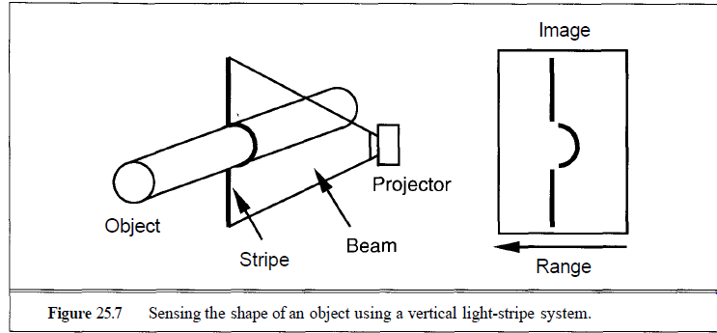

Slide 24
